Slide 1
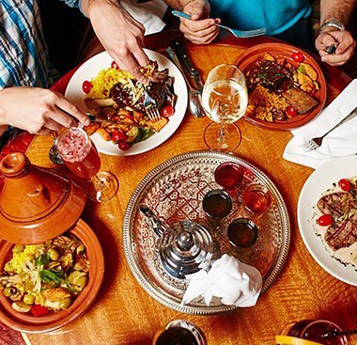
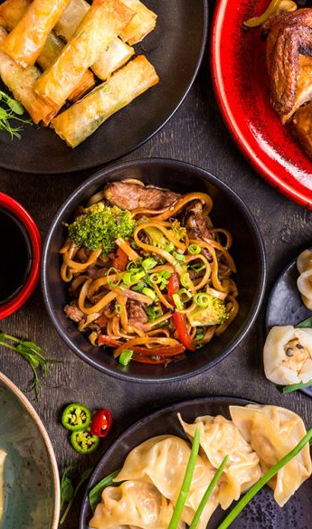
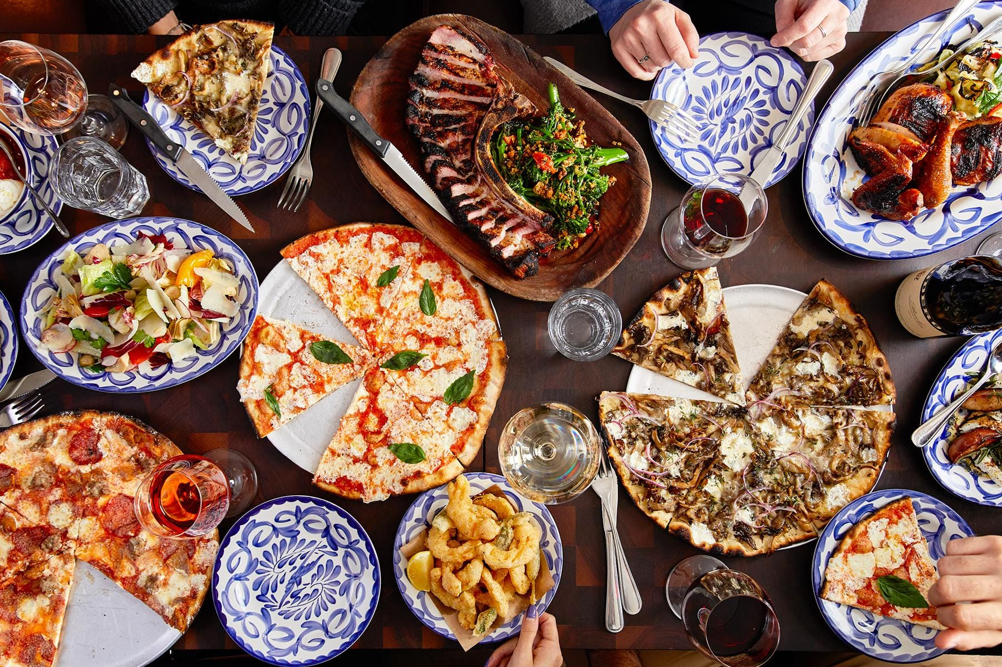
Comparing Food Cuisines - Downtown Toronto vs New York, Manhattan
Applied Data Science Capstone
IBM Data Science Certificate
2019
Tharusha Morgan
Business Intelligence Developer

Slide 2
Steps taken to prepare data analysis
Problem
Data Collection
Data Preparation
Visualization
Machine Learning

Slide 3

Problem
The idea of this study is to identify the difference between food in Toronto, Canada and New York City, USA.
The questions that are been asked are, how does the different types of cuisines in Toronto differ from New York? Are there any regions that are dominant?
These are the kinds of questions that is going to be investigated in the Notebook and its findings. The data insights will let us know.
The aim of the task is to find which areas are common with the different cuisines.

Slide 4
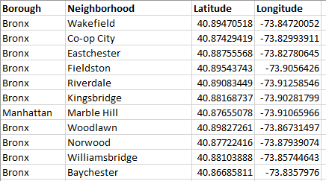
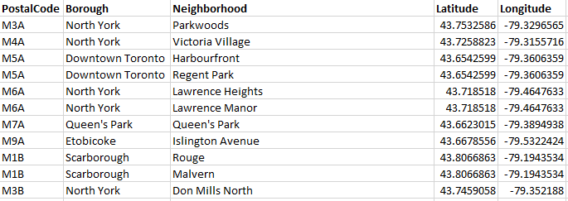
Data collection
The data is collected from different source and they have been refined a number of times to get the perfect csv format file.
Two csv files containing the data of boroughs and neighborhoods. One file for Toronto and other for New York City.
Toronto Data: A Wikipedia article: List of Postal Codes of Canada_M.
New York Data: https://cocl.us/new_york_dataset

Slide 5
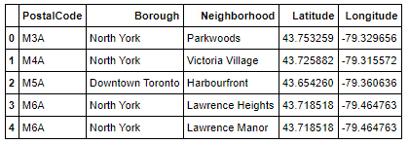
Data collection
In order to get the table of Postal Codes from the Wiki URL - A package called BeautifulSoup was used.
BeautifulSoup is a python package for scraping HTML webpages. Using this package I scraped the entire webpage. Then from the scraped webpage I extracted the necessary tags and converted it into a pandas DataFrame.
Finally after merging this dataset with the already scrapped data, the final dataset is generated
Now that Toronto has been allocated, New York is the next. For this, there is no need to scrape the webpage. The dataset is available as a JSON File in NYU Spatial Data Repository. From this, the GeoJson file is downloaded and the relevant data is extracted.

Slide 6
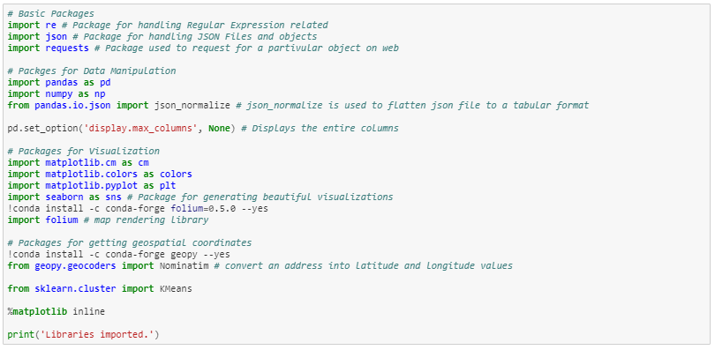
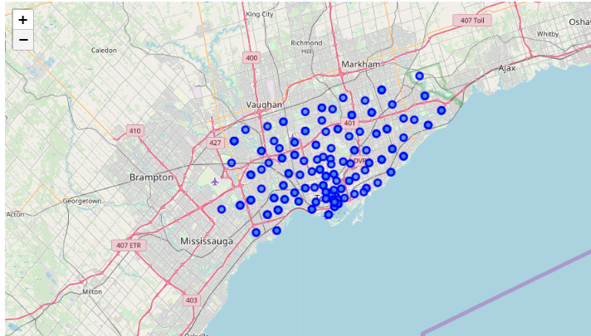
Data preparation
Importing the necessary packages.
The preprocessing was done in two phases, first one regarding the Toronto Dataset and second one regarding New York Dataset. In the first phase, Toronto Dataset was loaded.
The blue dots on the map are the neighborhoods in different boroughs. For this analysis I took the Downtown Toronto Borough

Slide 7
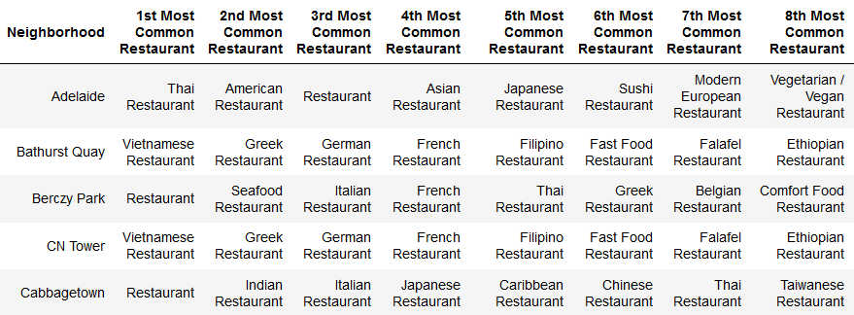
Data preparation
Finally using the Foursquare API in conjunction with the created datasets, a table of most common restaurants in Downtown Toronto is generated.
In phase two, New York Data was used. Here Manhattan is used as a Borough for analysis.

Slide 8
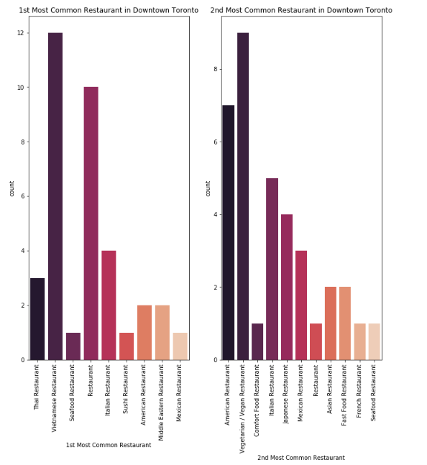
visualization
From the graphs it is clear that Vietnamese Restaurant is 1st Most Common Restaurant in Downtown Toronto Area. However we can also see another value named just ‘Restaurant’. This can be considered as a discrepancy as we don’t know what kind of cuisine that restaurant serves. We can assume that this restaurant serves majority of cuisines.

Slide 9
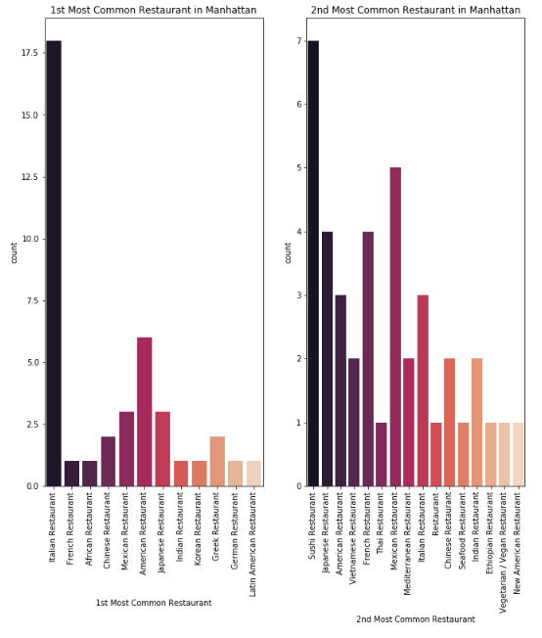
visualization
We can see that Italian and American Restaurants dominate the 1st Most Common Restaurants in Manhattan.

Slide 10
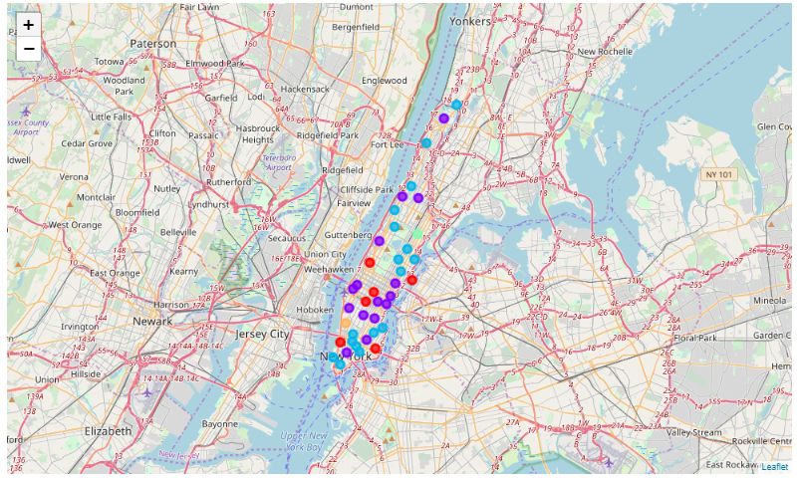
Machine learning
K Means Clustering Algorithm is used to generate clusters for these two cities. Sci-Kit Learn is the package used for this algorithm. These clusters are based on the common restaurants. These clusters are then visualized using folium

